Slide 1
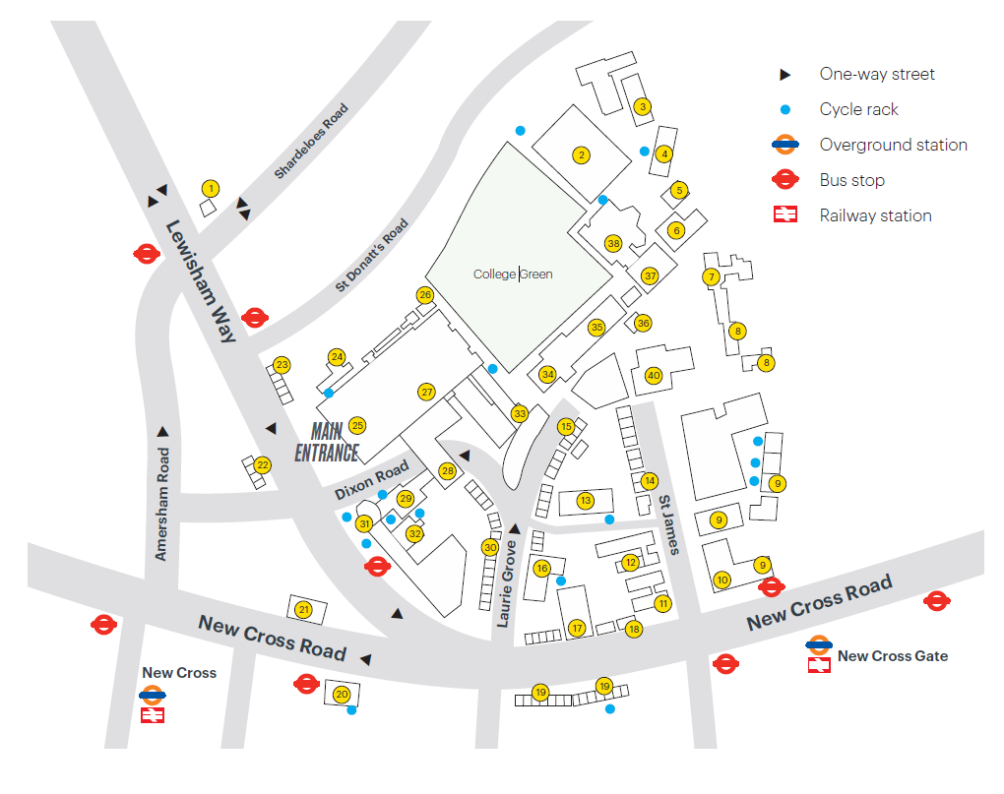
Goldsmiths Map App
Ian Gulland Lecture Theatre
Notes:
30 seconds

Slide 2
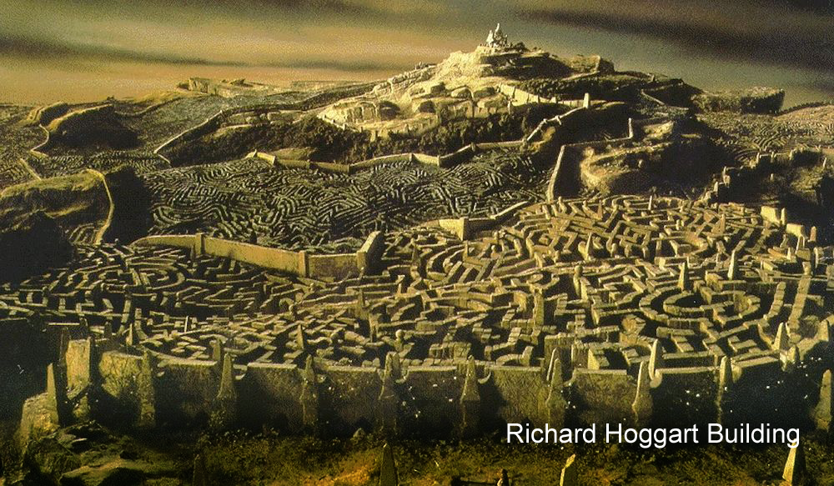
Notes:
The Motivation

Slide 3
Aims & Objectives
To create a user friendly android application
To include an offline pathfinder
To include a search feature to locate buildings and rooms
Notes:
1 minute

Slide 4



Design
Intended for offline use
Created with accessibility in mind
An Intuitive and user friendly application
Notes:
1 minute

Slide 5
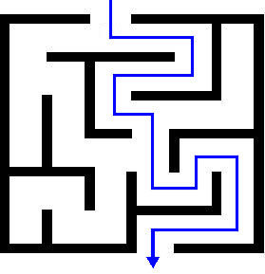



Research
Used to get feedback on the current design
Used to verify the target audience
Shows the demand for the application
Notes:
1 minute

Slide 6





Development
Group Meetings
Milestones
Gantt Chart
Github
Notes:
1 minute

Slide 7
Outcomes to date
Selected the A* path finding algorithm
Created Node maps of each building
Designed Prototype
Currently halfway through the milestones
Notes:
1 minute

Slide 8
Future Plans
To extract the data from the node maps efficiently
Additional Research to find suitable data structures
Redesign the aesthetics based on user feedback
Implementing a working version for android

Slide 9


